Slide 1

Why
MUST
we
DISCIPLINE?
“The practice of training people to obey rules or a code of behavior, using punishment to correct disobedience”
(oxforddictionaries.com)

Slide 2

Why
MUST
we
DISCIPLINE?

Slide 3

TO PLEASE JESUS
“As many as I love, I rebuke and chasten. Therefore be zealous and repent.”
—Revelation 3:19

Slide 4
TO PLEASE JESUS
“But we command you, brethren, in the name of our Lord Jesus Christ, that you withdraw from every brother who walks disorderly and not according to the tradition which he received from us.”
—2 Thessalonians 3:6

Slide 5
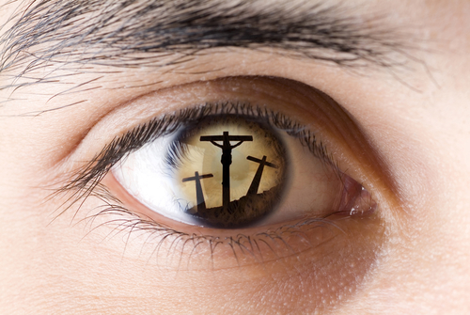
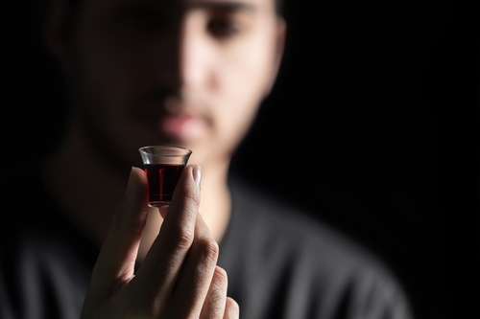
How We View Discipline Will Reflect How We View The Nature of the Church

Slide 6
TO DEMONSTRATE THE LOVE OF GOD
“You should know in your heart that as a man chastens his son, so the LORD your God chastens you.”
—Deuteronomy 8:5
Prov. 3:11, 12 | 1 Cor. 11:32 | Heb. 12:5

Slide 7
DID JESUS LOVE THESE:
Peter?
  Mark 8:33
The eleven?
  Mark 16:14
The people?
  John 6:26
The churches?
  Revelation 2-3
YES!
John 13:1, 34

Slide 8
Does The Church Love God, Jesus, The Holy Spirit, And Brethren When She Fails To
“Warn” And “Withdraw”
From Those Walking Disorderly?
1 Thess. 5:14| 2 Thess. 3:6

Slide 9
Will you begin to please Jesus today?
Will you yield complete submission to His word today?
Will you obey the gospel in repentance and baptism today?

